Slide 1
Project 2

Slide 2
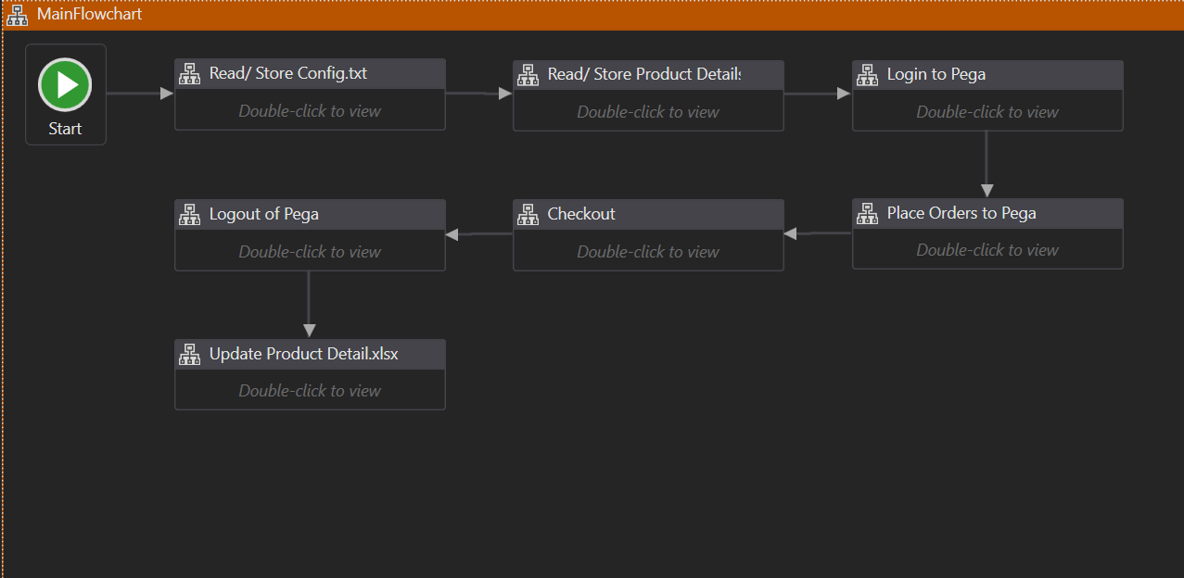

Slide 3
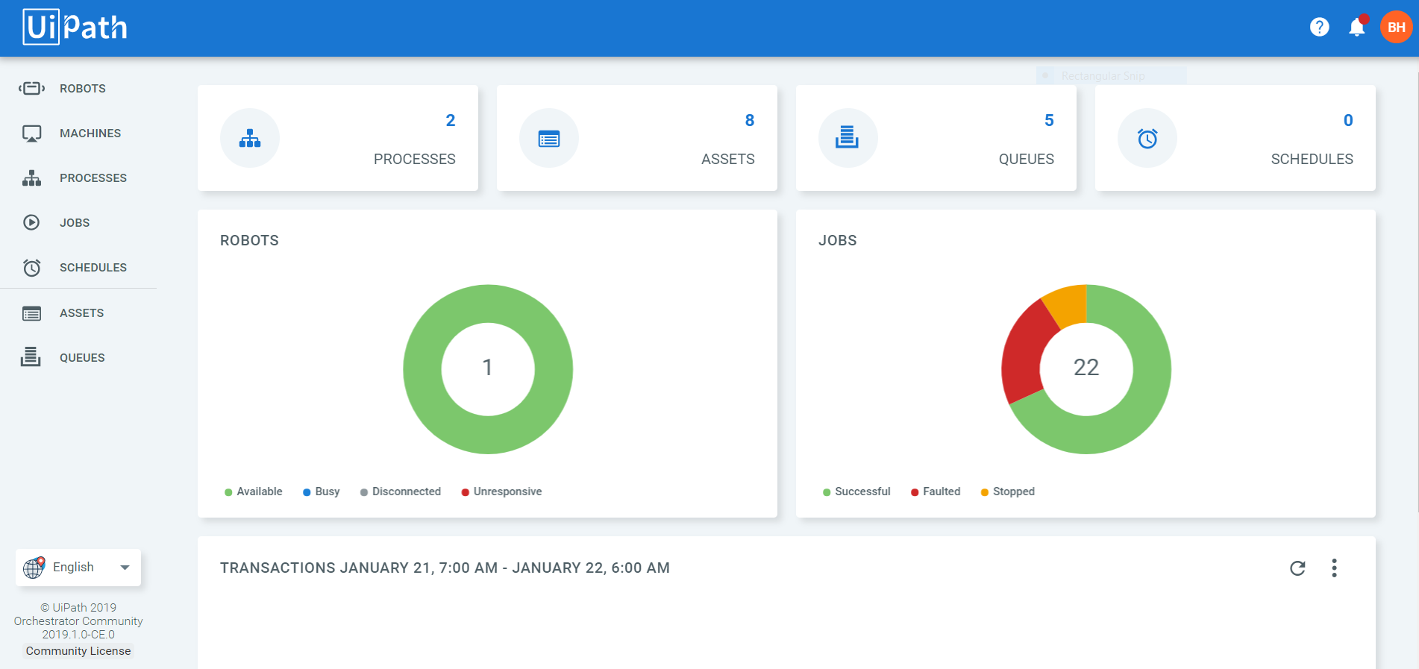

Slide 4
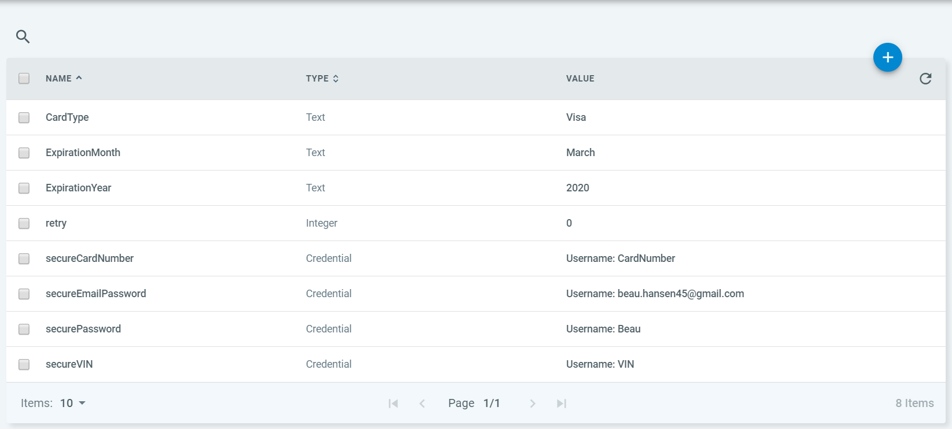
Assets and Credentials
Abstraction
Security
Separation of Concerns

Slide 5
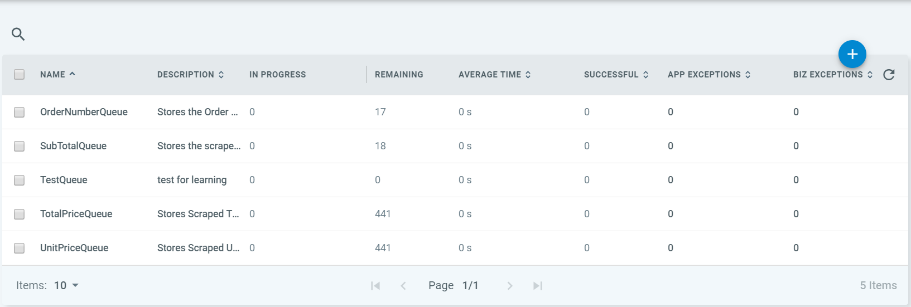
Queues and Transactions
Reusability
Security

Slide 6

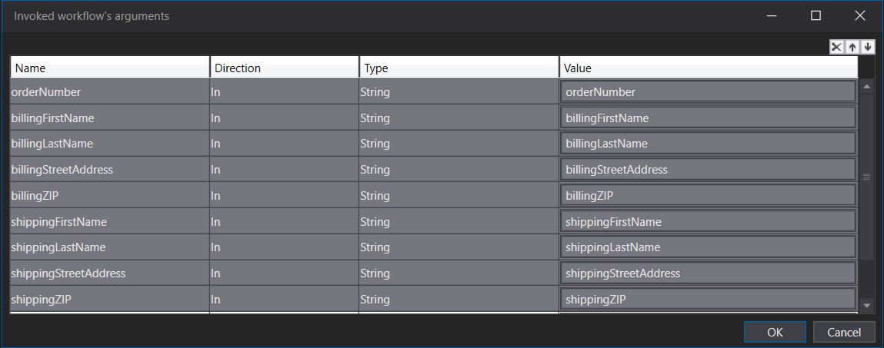
Managing Abstraction
Separate Workflows

Slide 7
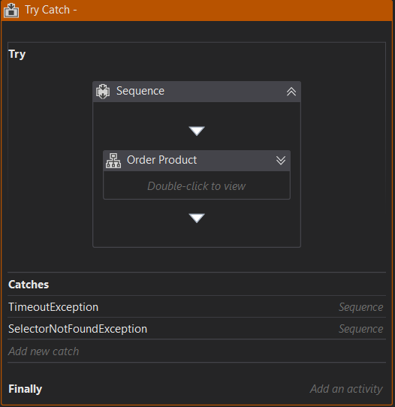
Exception Handling
Try-Catch Activity

Slide 8
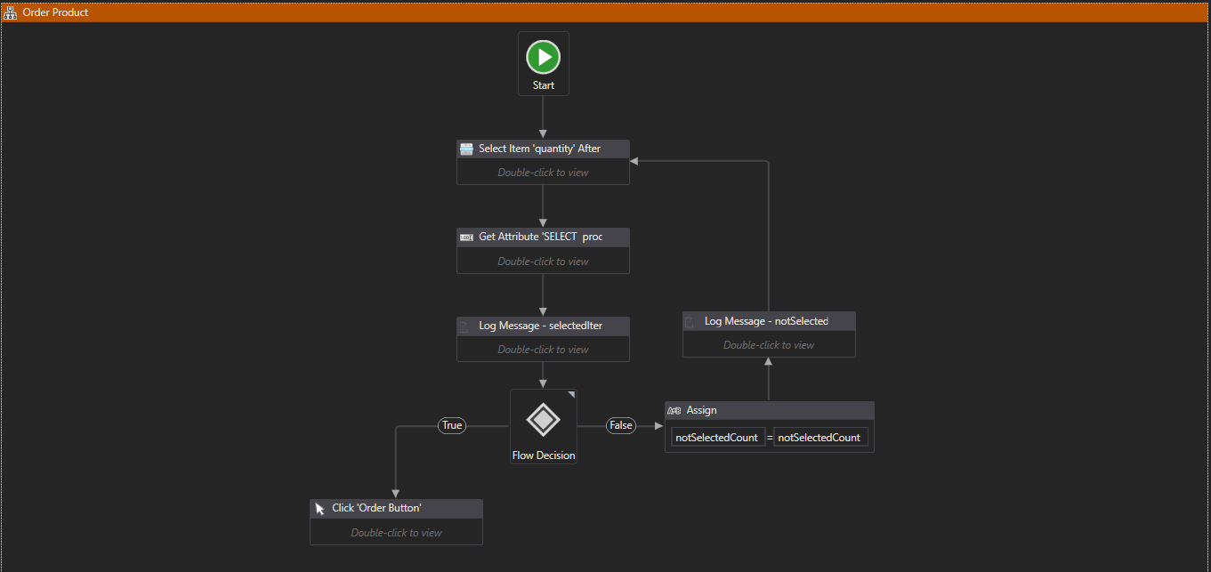

Slide 9
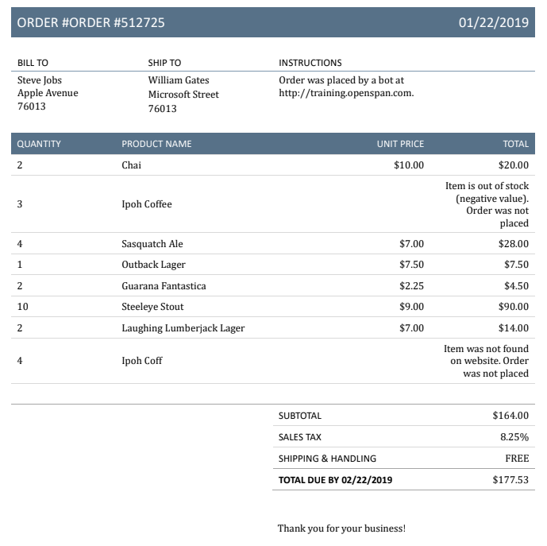
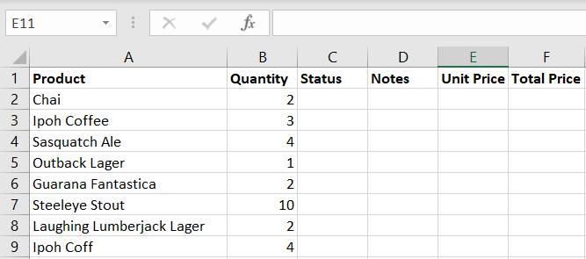

Demonstration

